Slide 1
CD NOZZLE ANALYSIS

Slide 2
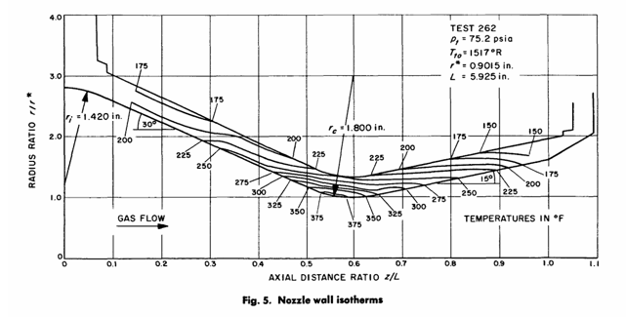
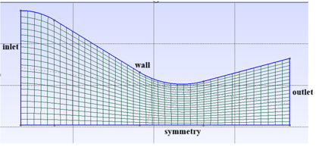
Coarse Mesh
Geometry of the nozzle

Slide 3
Boundary Type | Marker Name | Parameter | Value
Inlet | inlet | TOTAL_CONDITIONS_PT | 1038350.4 Pa (Total Pressure), 824.44 K (Total Temperature)
Outlet | outlet | STATIC_PRESSURE | 59147.39 Pa
Wall | wall | Euler (inviscid slip wall) | -
Symmetry | symmetry | - | -

Slide 4
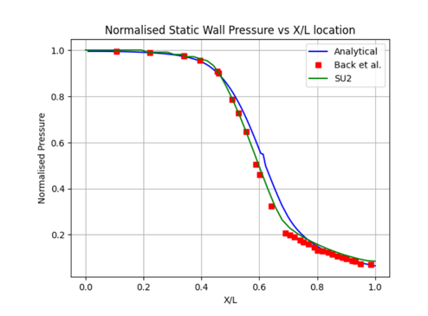
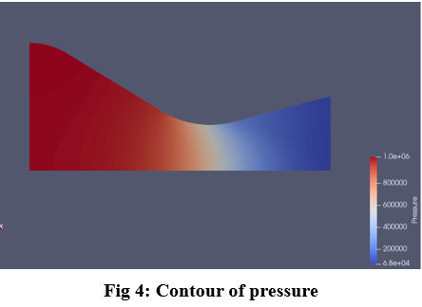
The flow is taken as inviscid, thus the Euler equations are solved with the boundary conditions as P0 = 1038350.4 Pa, T0 = 824.44 K and Pb = 59147.39 Pa.
Comparing the SU2 results with the Analytical and Experimental Results

Slide 5
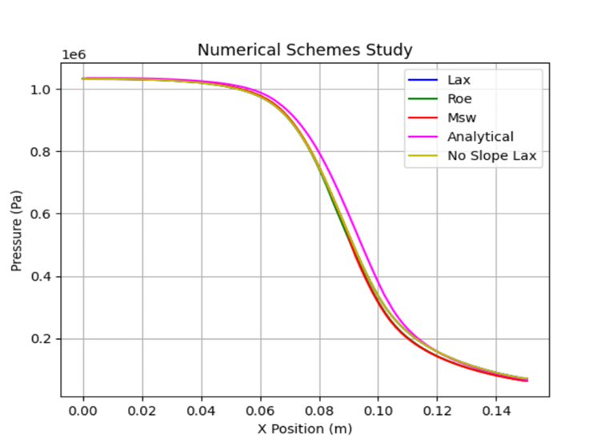
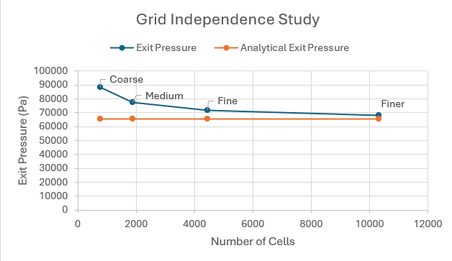
The fine mesh was considered the most appropriate one and taken for further studies.

Slide 6
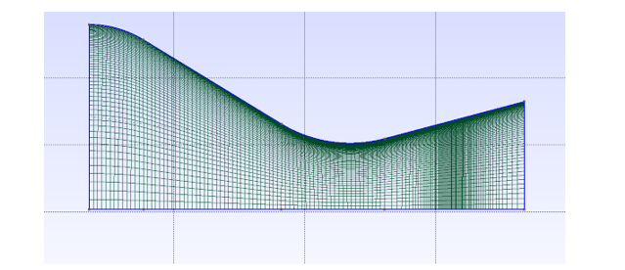
Shock Case
Boundary Type | Marker Name | Parameter | Value
Inlet | inlet | TOTAL_CONDITIONS | 308885.1 Pa (Total Pressure), 835 K (Total Temperature)
Outlet | outlet | STATIC_PRESSURE | 92665.53 Pa
Wall | wall | Navier-Stokes (no-slip) | Constant Viscosity
Symmetry | symmetry | - | -
Fig 1: Mesh
The flow is taken as viscous. Thus the mesh is refined at the boundary and at the position of the shock. Roe convective scheme and Venkatkrishnan slope limiter were applied and viscosity is taken as constant.

Slide 7
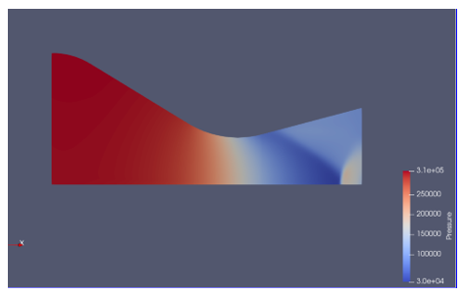
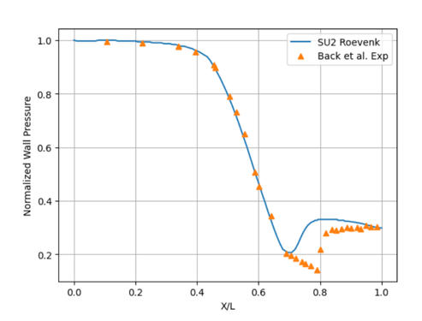
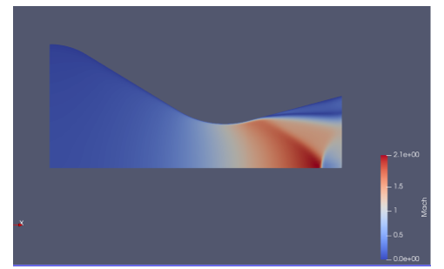
Shock Case
Pressure Contour
Comparison with experimental data
Mach Number Contour

